Slide 1
3. Numeric Types, Expression and Output
C++ Programming Language
🧑🏻‍💻 Go C++ 👩🏻‍💻

Slide 2
Agenda
What is a variable?
What are the Data types?
Expression and Output

Slide 3
What is a variable?

Slide 4
Variable
Variable
Definition
➔ Memory space for storing the data
Feature
- To use a variable, you need to declare it
- Variable can change the data in the variable
- C language reserved words cannot be used as variable names.

Slide 5
Variable
Primitive Type
boolean, char, short, int , float , double
Reference Type
It store the address.
1. Every variable has a type, and the type and range of values ​​that
can be stored vary depending on the type.
2. Primitive types store data values, while reference types store
address values ​​that have data.

Slide 6
Variable
Variable Declaration
10
20
int x = 10; // declaration
int y = 20;
x = 30;
cout << x << “ “ << y << endl; // 30 20
x
y
30
20
x
y

Slide 7
Constant
Constant
Definition
➔ The value that can no longer be changed
Feature
- Variables designated as constants can no longer change data
- Variable can change the data in the variable
- C language reserved words cannot be used as variable names.
( int if (x) )

Slide 8
Constant
Constant Declaration
const int x = 10; // declaration
const int y = 20;
x = 30; // compile error
cout << x << “ “ << y << endl;
10
20
x
y

Slide 9
What are the Data types?

Slide 10
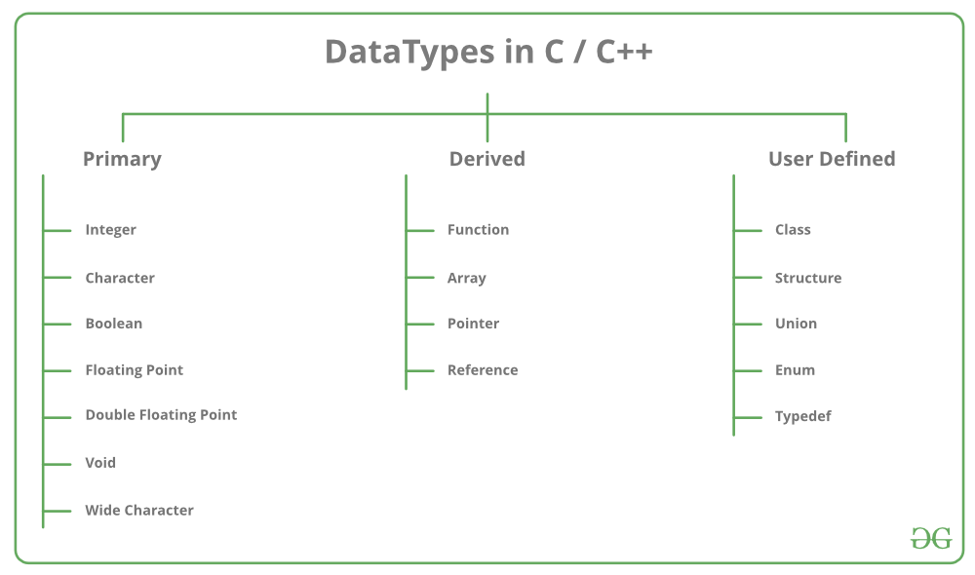
Data Types

Slide 11
Expression and Output

Slide 12
Expression
Definition
An expression is a valid arrangement of variables, constants, and
operators
In c++, each expression can be calculated as a value of a given
type.
ex) 4 + 5 , 5.6 – 2.3

Slide 13
Output
Definition
The result of the expression being calculated by the arithmetic
operator
Ex) int a = 4 + 5
int b = 8 – 3

Slide 14
Thank You
🧑🏻‍💻 Go C++ 👩🏻‍💻

